Slide 1
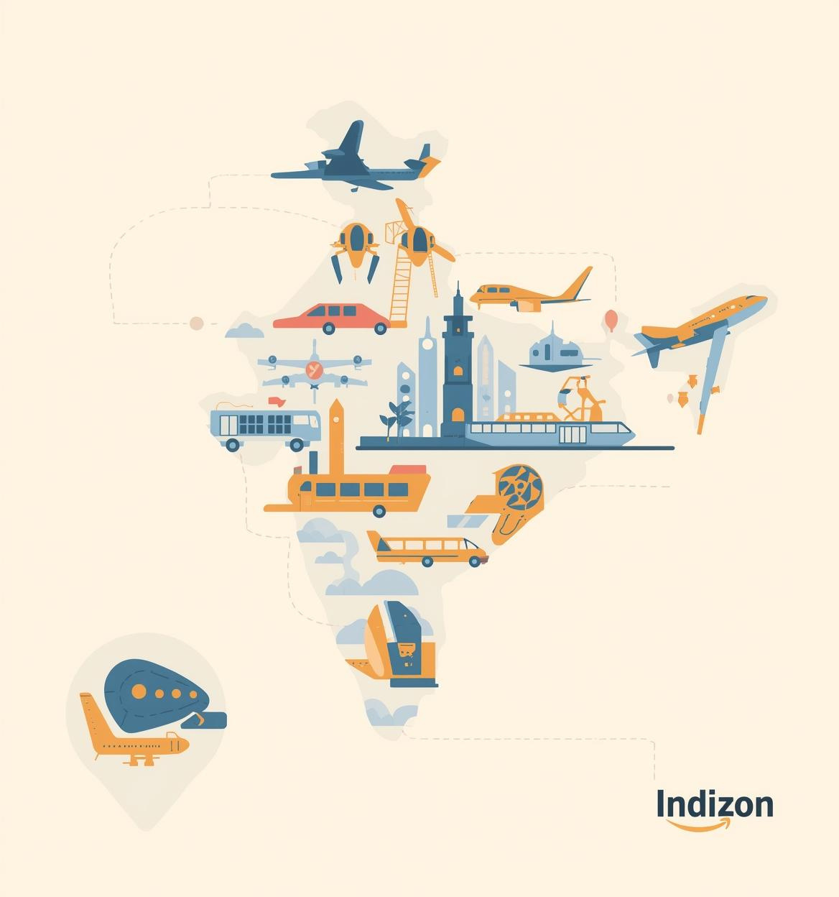

Bharat
Yatra
Project by Lucky
Batch – Cloud Computing

Slide 2
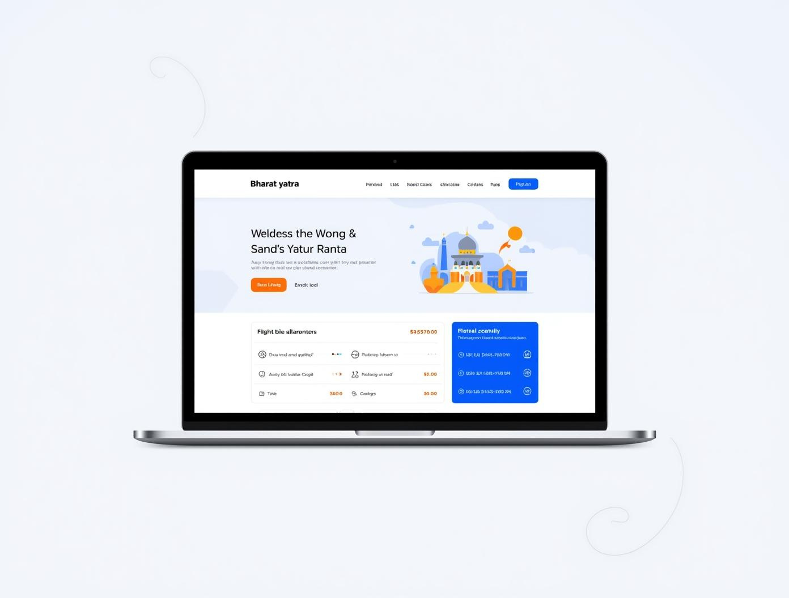
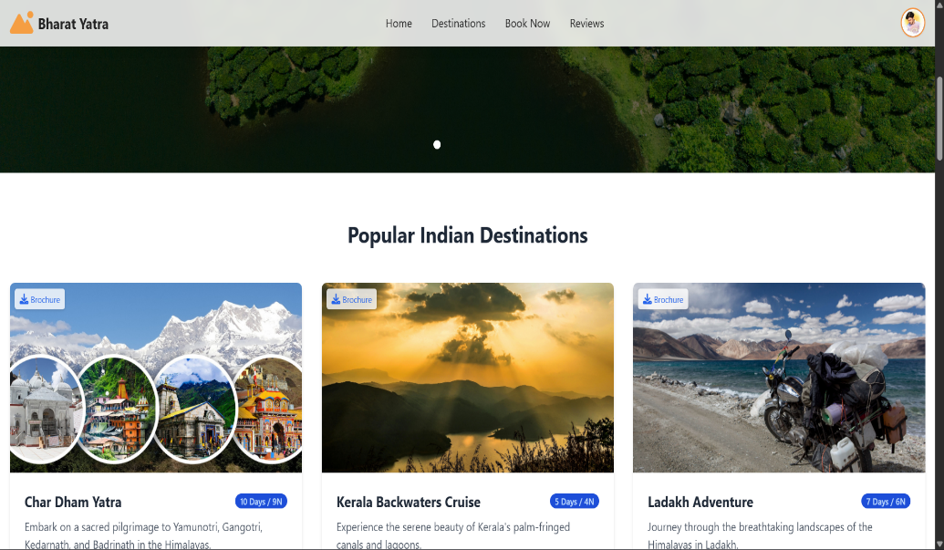
Key Features of Bharat Yatra
Key Features
Seamless booking experience with personalized recommendations and updates

Slide 3
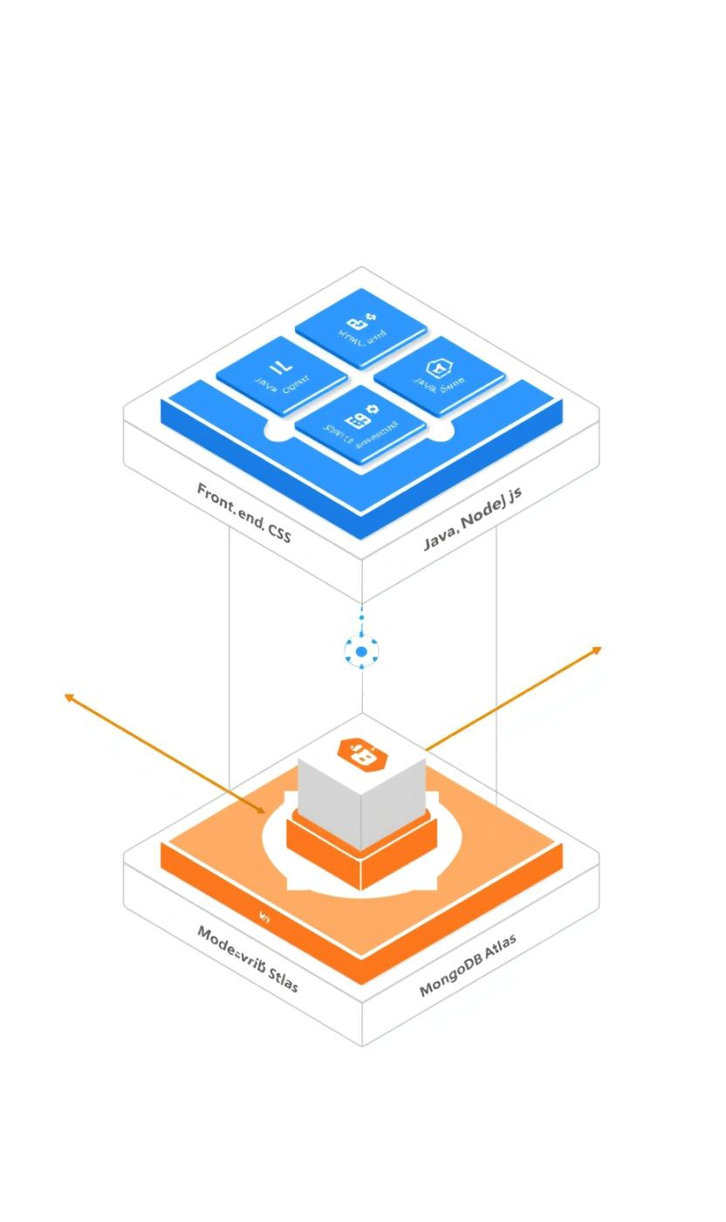
System Architecture
Front-end
The front-end utilizes HTML, CSS, and JavaScript to create a responsive user interface that enhances user interaction.
Back-end
Database
Built with Java and Node.js for robust server-side functionality.
Utilizes MongoDB Atlas for scalable data storage and management.

Slide 4
Technology Stack Overview
Front-End
The front-end is developed using HTML, CSS, and JavaScript, providing a responsive and user-friendly interface for travelers.
Back-End
The back-end utilizes Java and Node.js to handle server operations, ensuring efficient data processing and application performance.

Slide 5
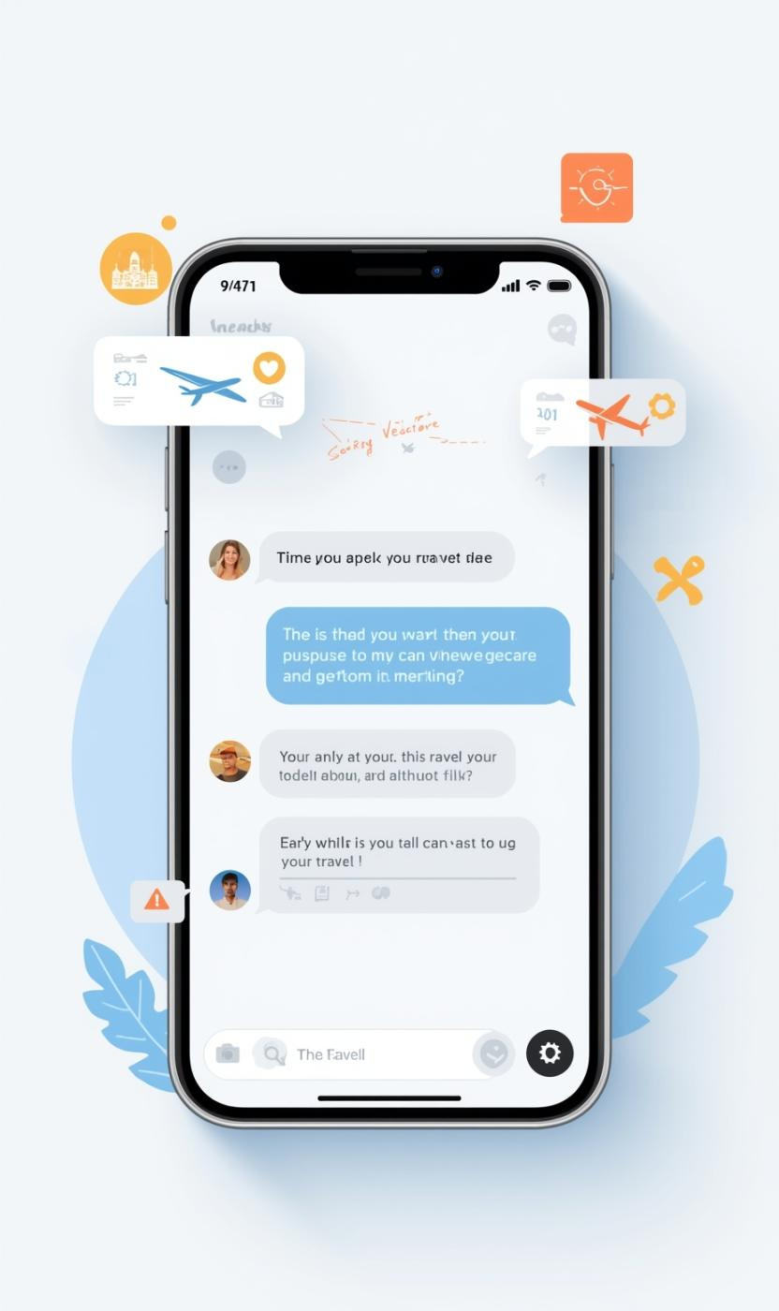

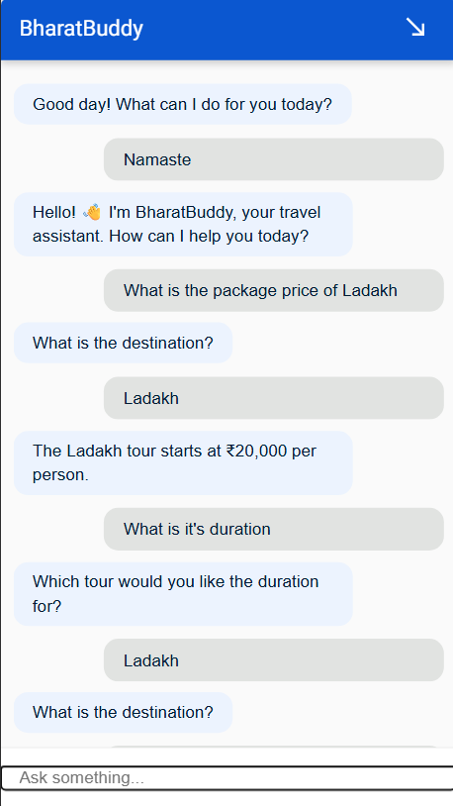
AI Chatbot
01
AI-powered travel assistance enhances user experience and satisfaction.
02
Google Dialogflow integration provides seamless conversational interactions.
03
Natural language processing enables understanding of user queries effectively.

Slide 6
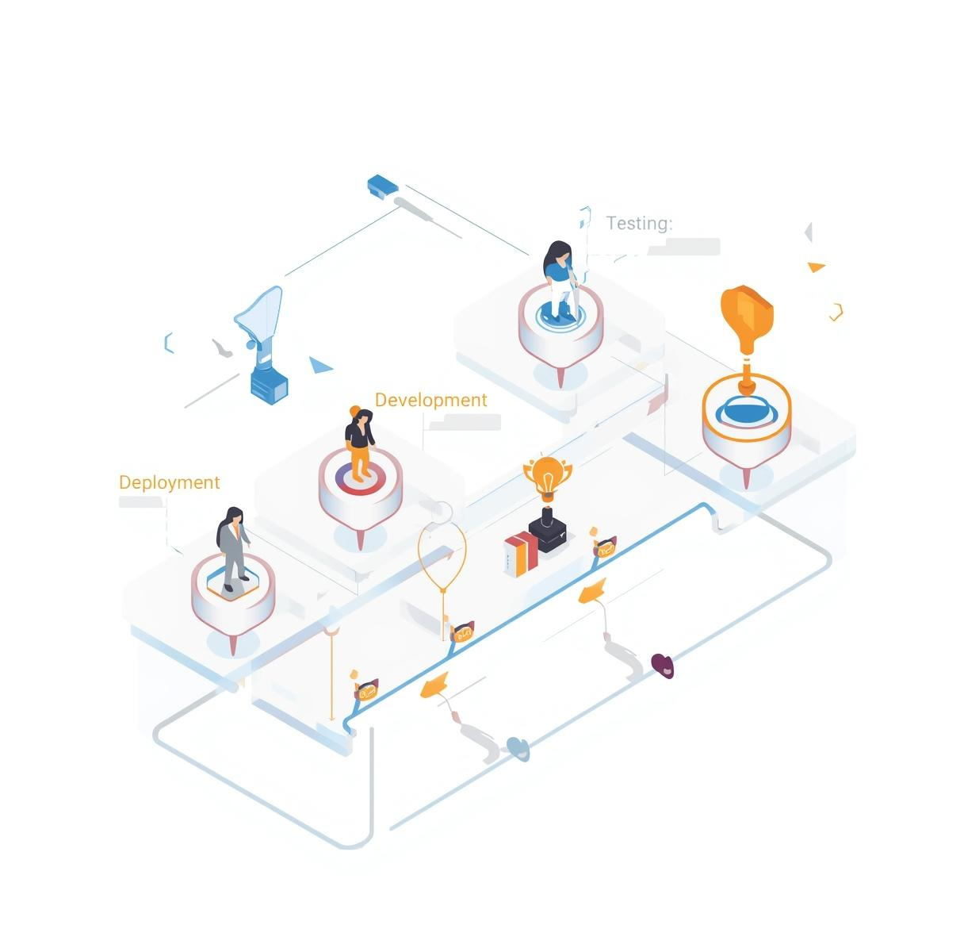
Project Timeline
The project timeline outlines the key milestones achieved throughout the development process. From the initial concept to the final deployment, each phase reflects our commitment to delivering a reliable and user-friendly travel booking application for our users.

Slide 7
Challenges Faced
Addressing key project difficulties
Data Integration
Scalability Issues
Security Considerations
Integrating disparate data sources posed a significant challenge, complicating the synchronization of travel information and user data across various platforms within the application architecture.
As the user base grows, ensuring that the application scales effectively while maintaining performance levels required careful planning and testing to handle increased demand on resources.
Protecting user data and ensuring transaction security were paramount, requiring robust security measures to mitigate risks associated with potential vulnerabilities throughout the application's infrastructure.

Slide 8
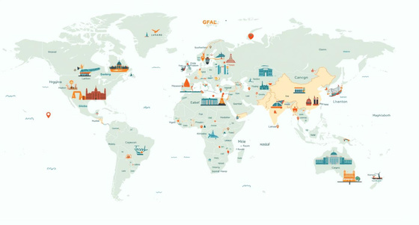
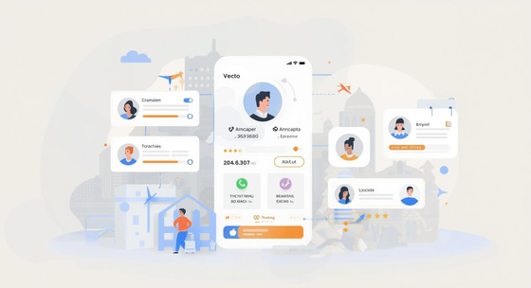

Future Enhancements for Bharat Yatra
Personalization
Tailored travel experiences based on user preferences.
Multi-Language
Support for various languages enhances user accessibility.
Travel Integration
Collaborations with additional travel service providers planned.

Slide 9
Conclusion
Project Impact
The Bharat Yatra application enhances user travel experiences through seamless booking and personalized recommendations. My technical expertise have delivered an innovative solution for modern travelers, encouraging efficient travel planning.

Slide 10
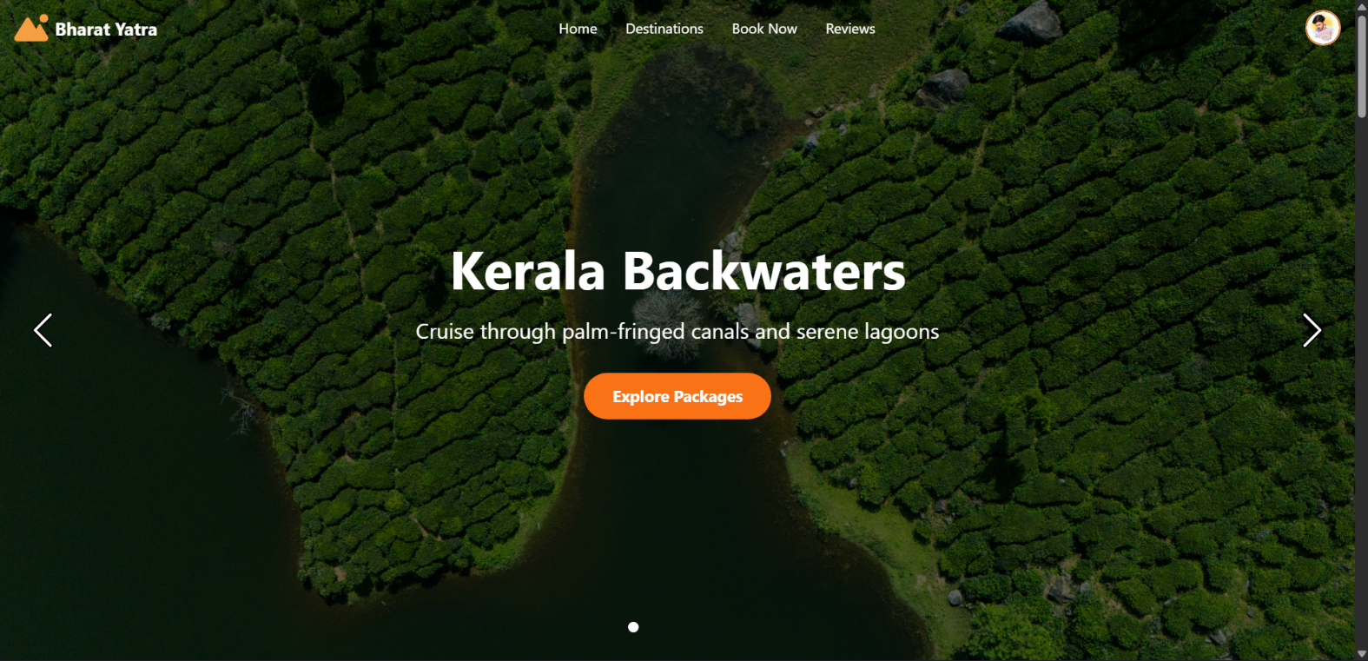

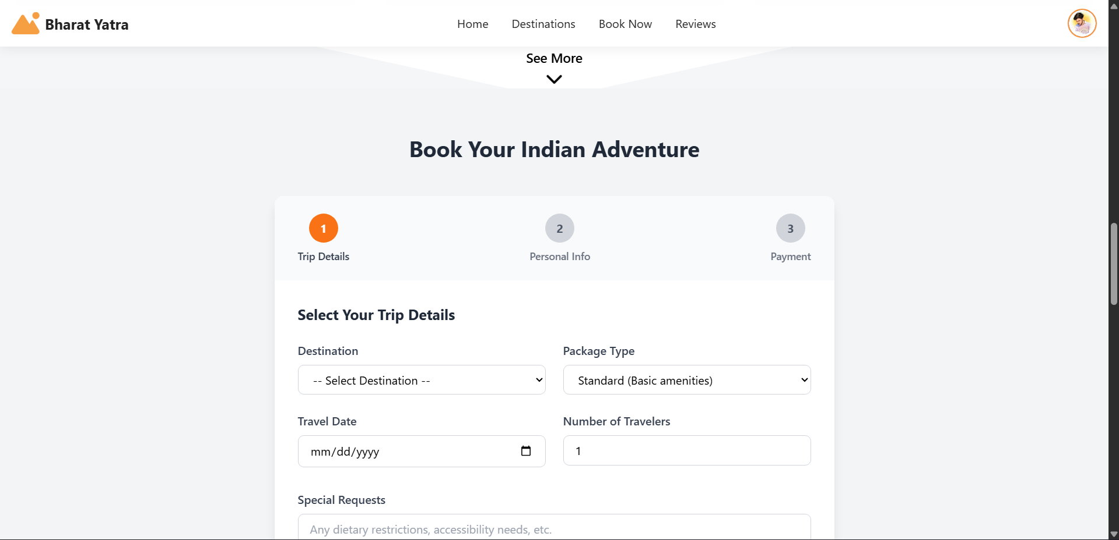
Live Demo
Interactive Experience
Experience the Bharat Yatra application firsthand, showcasing its user-friendly interface, seamless travel booking process, and integrated AI chatbot, enhancing every aspect of travel planning.

Slide 11
Thank You

